Slide 1
PROJECT PROPOSAL
HEART DISEASE PREDICTION USING MACHINE LEARNING
NAME: MUHAMMAD HUSSAIN
FATHER NAME: KALB ALI
MOBILE NO: 03111667720
EMAIL:mhussainsmr6@gmail.com
Course : Advance python programming and applications
CENTER: APTECH LEARNING SHAHRAH FAISAL KARACHI

Slide 2
HEART DISEASE PREDICTION USING MACHINE LEARNING
Guide : DR .SYED MASROOR ALI
A Project Report on
HEART DISEASE PREDICTION USING MACHINE LEARNING
Submitted in partial fulfillment of the requirements
for the certificate of “Advance python programming and applications “ in Aptech learning(National Vocational and Technical Training Commission )
Under the guidance of
DR .SYED MASROOR ALI

Slide 3
Project Development and design
Technical Approach & Python libraries Discussion
The solution I am proposing is to use Python as the primary language in implementing a
machine learning model that will predict whether a person has a heart disease or not. This model
will be implemented through Jupyter Notebook. I will import several libraries such as:
• Numpy – a numeric library in Python that can work with linear algebra as well as arrays.
• Pandas – this library in Python is used for data analysis and machine learning. It is used
to manipulate and analyze the csv files and data frame.

Slide 4
• Matplotlib – this library in Python is used for plotting and visualizing the data. It will
help in plotting graphs, line plots, histograms, etc. as well define parameters for the
charts, and color the charts.
• train_test_split – this scikit-learn library in Python will be used to split the dataset into
two parts – training dataset and test dataset.
• StandardScalar – this scikit-learn library in Python will be performed as a preprocessing
step in order to standardize the functionality of the input dataset.
Next, using the scikit-learn, or sklearn, library in Python, I import the four machine learning
algorithms that will be used to implement the model which will predict heart disease in a person.

Slide 5
DECLARATION :
I MUHAMMAD HUSSAIN hereby declare that the Project Report entitled Heart disease prediction using machine learning done by me under the guidance of DR .SYED MASROOR ALI is submitted in partial fulfillment of the requirements for the award of certificate in “Advance python programming and applications “
PROPOSED SYSTEM
World Health Organization has estimated that four out of five cardiovascular disease (CVD) deaths are due to heart attacks. This whole research intends to pinpoint the ratio of patients who possess a good chance of being affected by CVD and also to predict the overall risk using Logistic Regression.

Slide 6
BLOCK DIAGRAM
Data Collection
preprocessing
Data Analysis
Evaluating the Model
Applications of Algorithms
Testing

Slide 7
Start
Train Dataset
Test Dataset
Logistic Regression
Build Model
Model Deploy

Slide 8
PROPOSED SYSTEM PHASES
Phase 1: Collection of data
The Dataset is from an ongoing cardiovascular study on residents of the town of Framingham, Massachusetts. The classification goal is to predict whether the patient has 10-year risk of future coronary heart disease (CHD). The dataset provides the patients’ information. It includes over 4240 records and 15 attributes.
Phase 2: Data preprocessing
Data preprocessing is the process of cleaning our data set. There might be missing values or
outliers in the dataset. These can be handled by data cleaning. If there are many missing
values in a variable we will drop those values or substitute it with the average value.

Slide 9
Phase 3: Training Model :
Split the dataset into training and testing sets.
Train a logistic regression model on the training data.
Tune hyperparameters (like the regularization strength) to optimize performance.
Phase 4: Testing
The trained model is applied to test dataset and heart disease are predicted.
phase 5: Model Evaluation:
Evaluate the model using the testing set.
Use metrics such as accuracy, precision, recall, and F1-score to assess performance.

Slide 10
phase 6: Deployment:
Develop a simple web or desktop application that allows medical professionals to input patient data and receive a risk prediction.
phase 6: Expected Outcomes:
A logistic regression model that accurately predicts heart disease.

Slide 11
Algorithm:
Logistic Regression in Machine Learning
Logistic regression is a supervised machine learning algorithm used for classification tasks where the goal is to predict the probability that an instance belongs to a given class or not. Logistic regression is a statistical algorithm which analyze the relationship between two data factors.

Slide 12
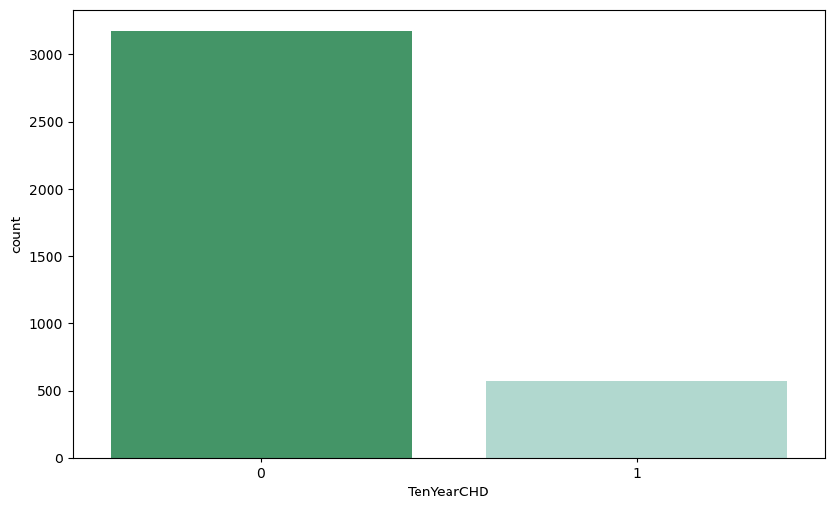
No of patients affected with coronary heart disease (CHD)

Slide 13
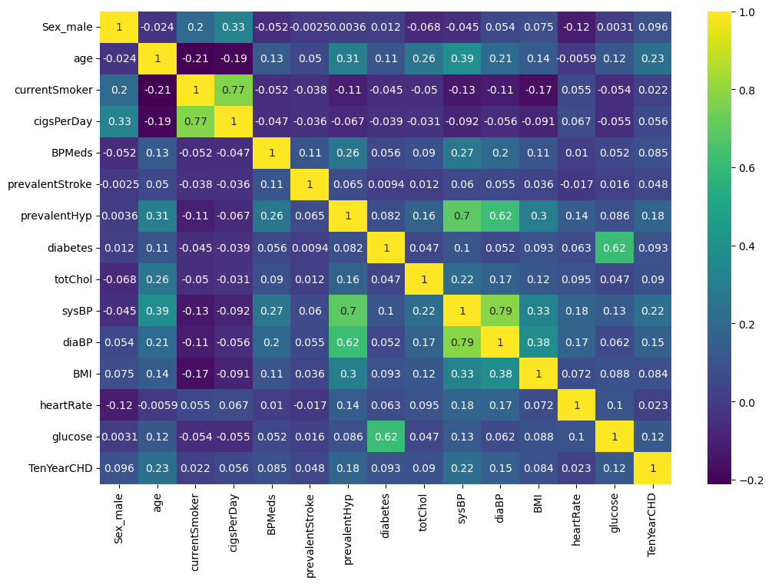
Heatmap

Slide 14
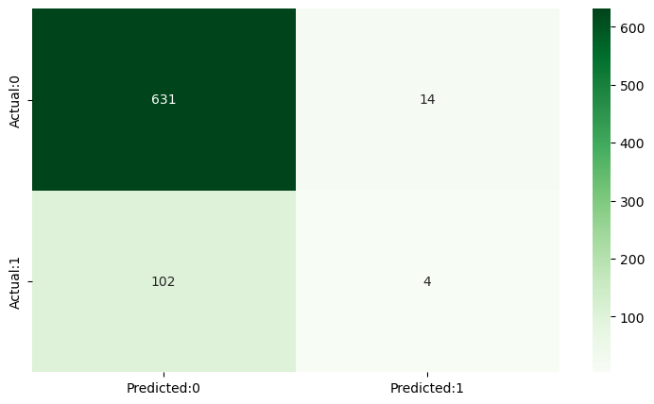
Confusion Matrix

Slide 15
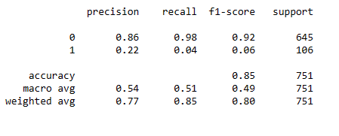
Model Accuracy

Slide 16
Acknowledgements:
I would like to thank Dr. Syed Masroor Ali for being my instructor for my project and for all his help throughout the entire course . And once again I would like to thanks to Dr. Syed Masroor Ali for accepting my request and he guided me through this project.

